Slide 1
Texture
Slides Acknowledgements
Steve Seitz
Kirsten Grauman, Vassilis Athitsos
Other Vision Researchers
Ebook: R. Szeliski

Slide 2
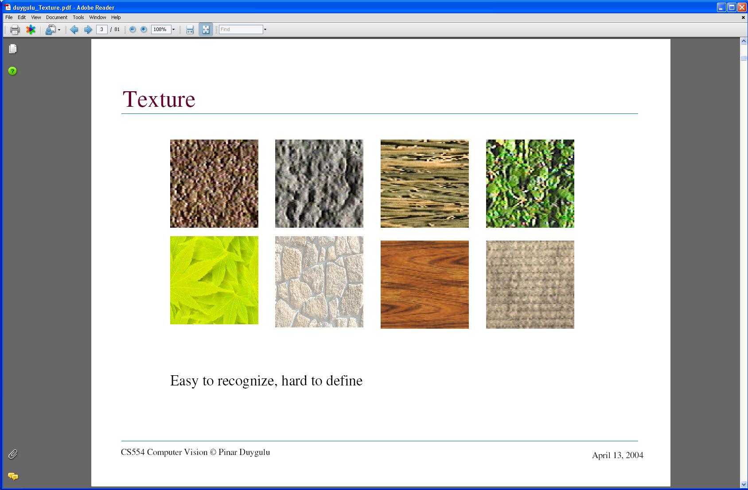
Texture
What defines a texture?

Slide 3
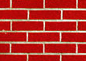

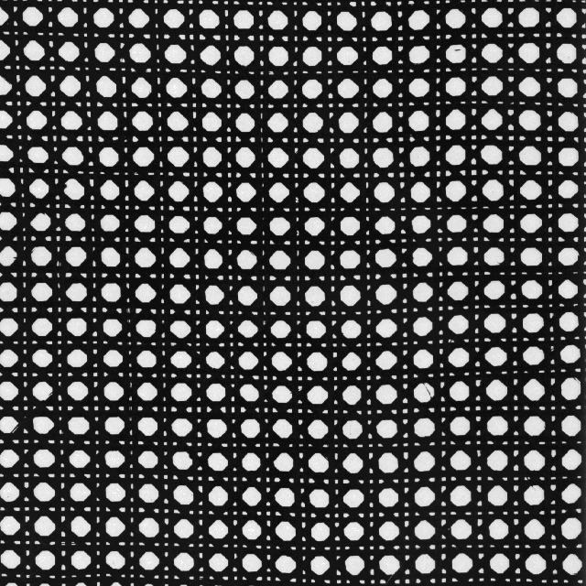
Includes: more regular patterns

Slide 4
Includes: more random patterns

Slide 5
Texture-related tasks
Shape from texture
Estimate surface orientation or shape from image texture

Slide 6
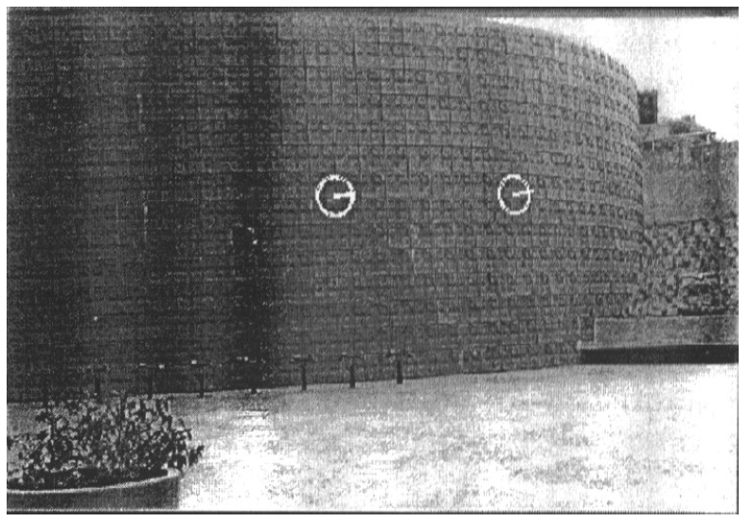
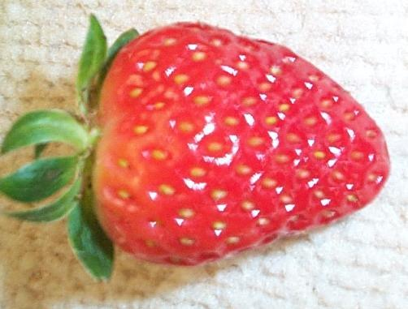
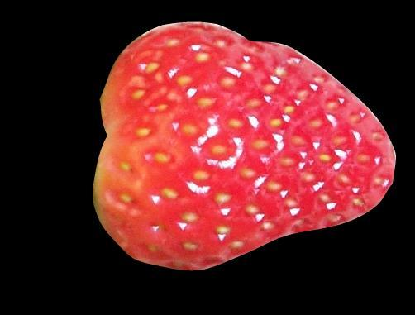
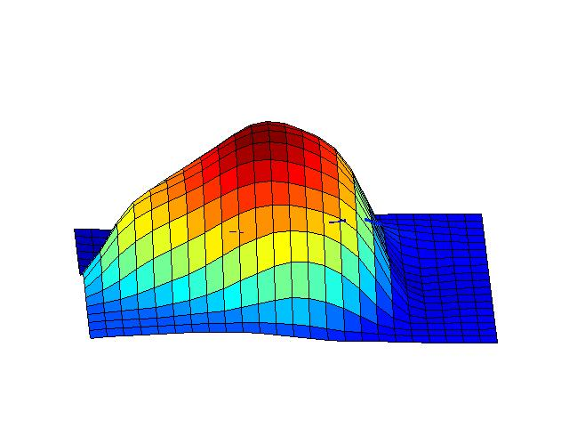

Shape from texture
Use deformation of texture from point to point to estimate surface shape
Pics from A. Loh: http://www.csse.uwa.edu.au/~angie/phdpics1.html

Slide 7
Texture-related tasks
Shape from texture
Estimate surface orientation or shape from image texture
Segmentation/classification from texture cues
Analyze, represent texture
Group image regions with consistent texture
Synthesis
Generate new texture patches/images given some examples

Slide 8
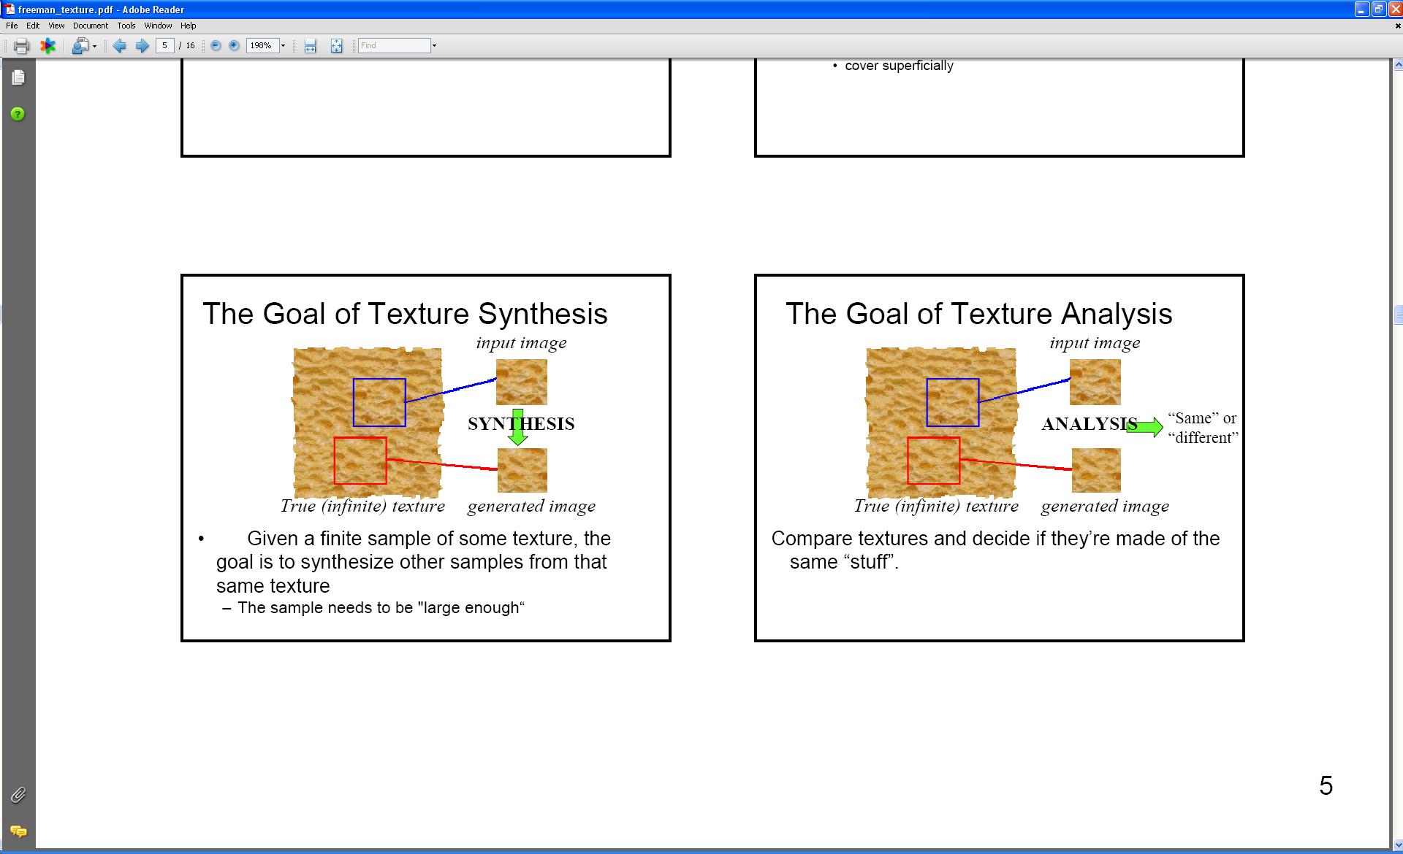
Analysis vs. Synthesis
Why analyze texture?
Images:Bill Freeman, A. Efros

Slide 9
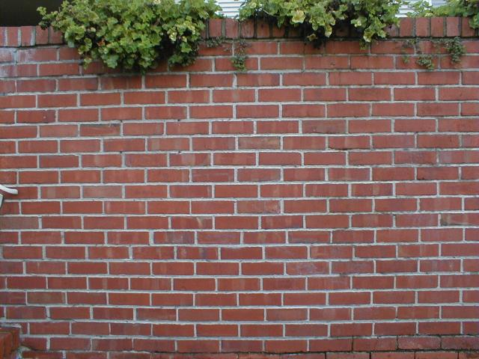
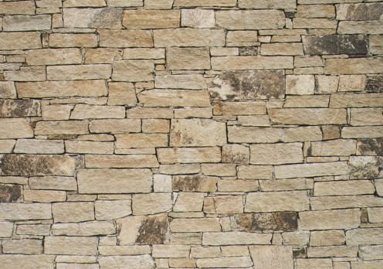
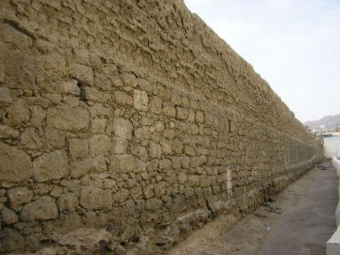
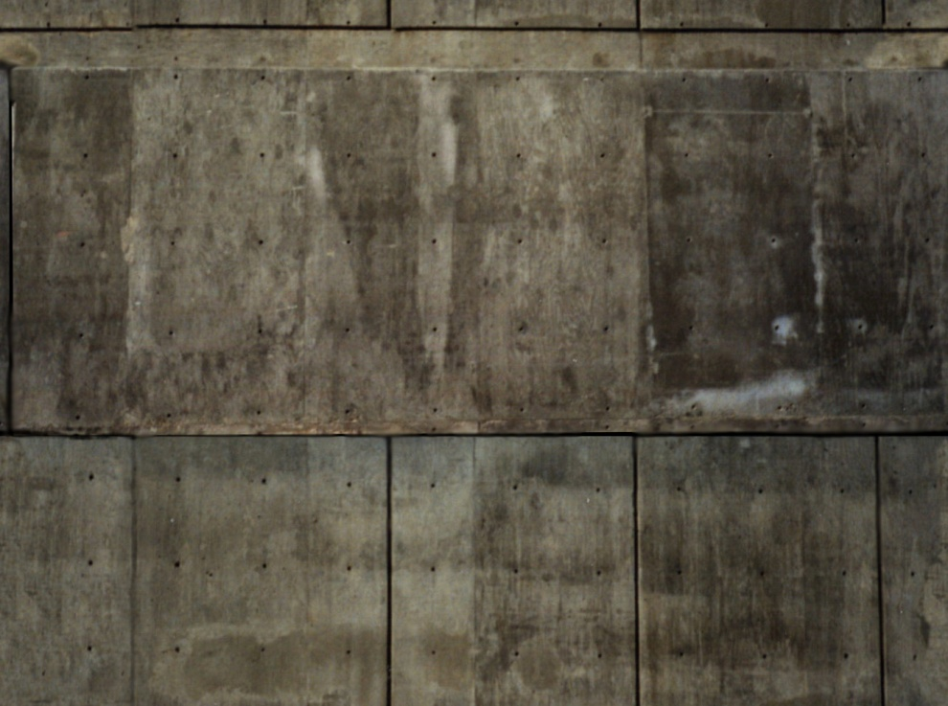
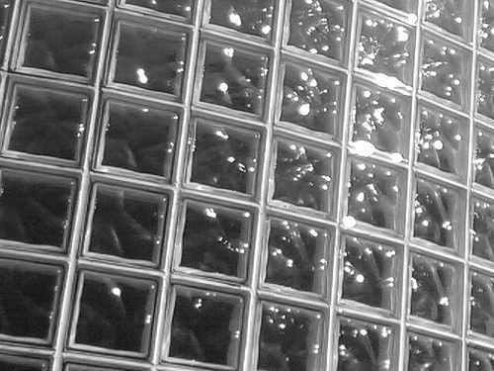

Slide 10
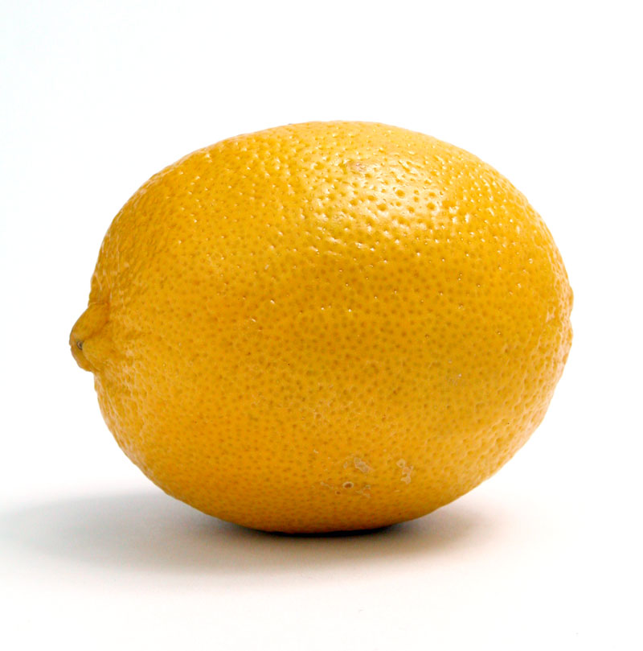
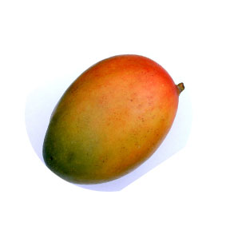
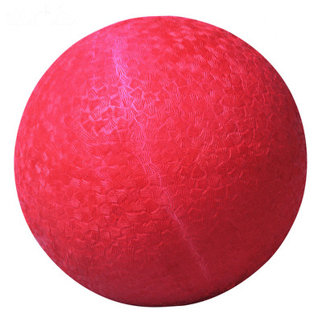
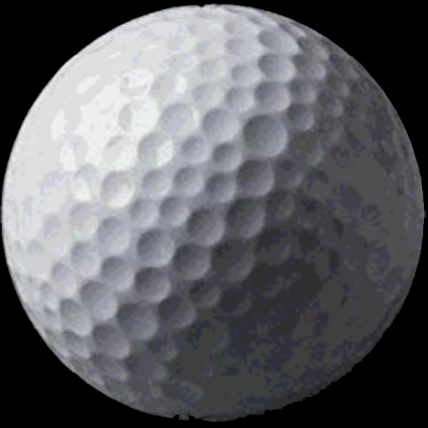

Slide 11
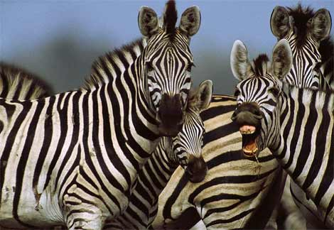
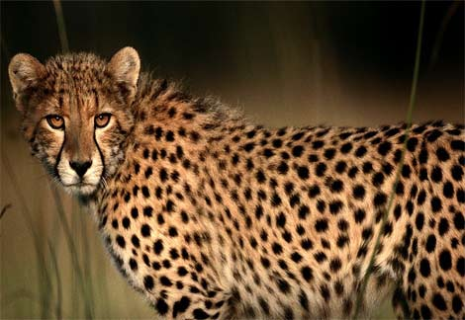
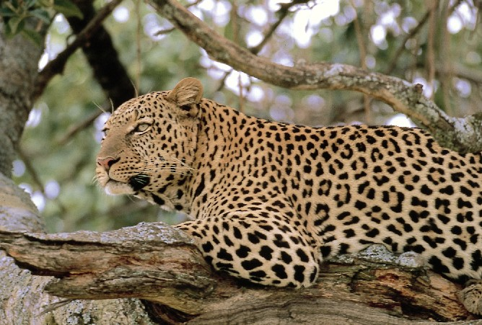
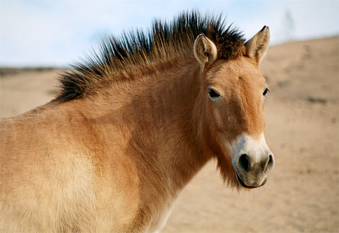
http://animals.nationalgeographic.com/

Slide 12
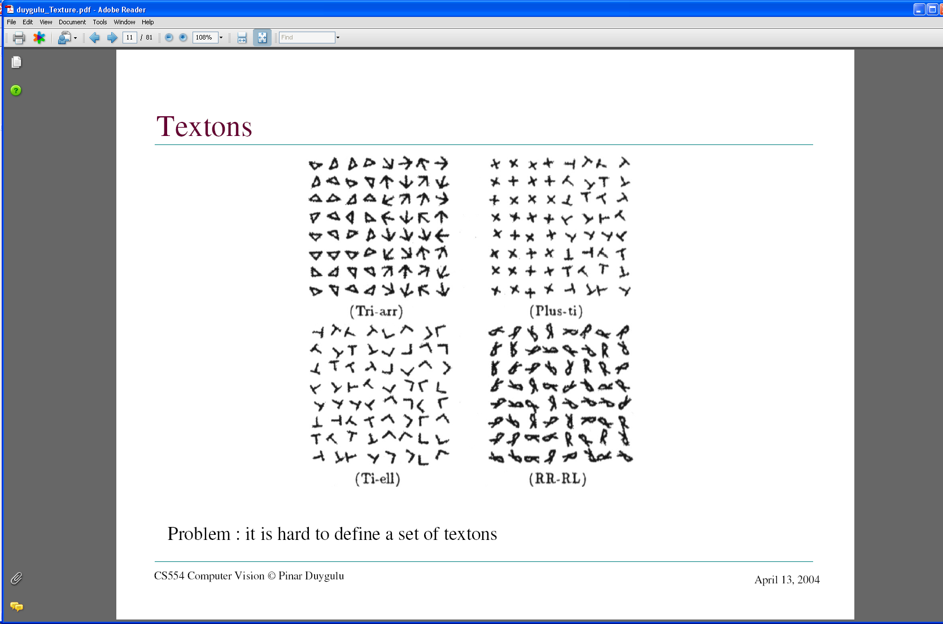
What kind of response will we get with an edge detector for these images?
Images from Malik and Perona, 1990

Slide 13
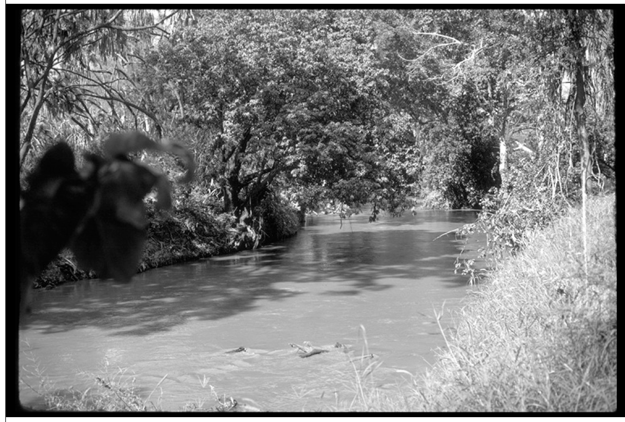
…and for this image?
Image credit: D. Forsyth

Slide 14
Why analyze texture?
Importance to perception:
Often indicative of a material’s properties
Can be important appearance cue, especially if shape is similar across objects
Aim to distinguish between shape, boundaries, and texture
Technically:
Representation-wise, we want a feature one step above “building blocks” of filters, edges.

Slide 15
Psychophysics of texture
Some textures distinguishable with preattentive perception– without scrutiny, eye movements [Julesz 1975]
Same or different?

Slide 16
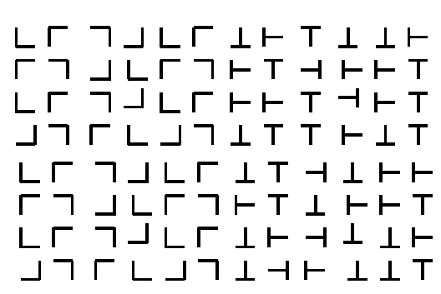

Slide 17
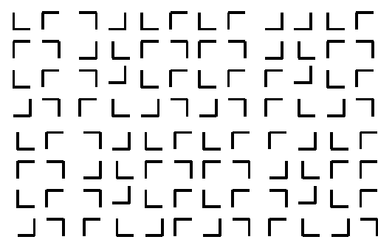

Slide 19
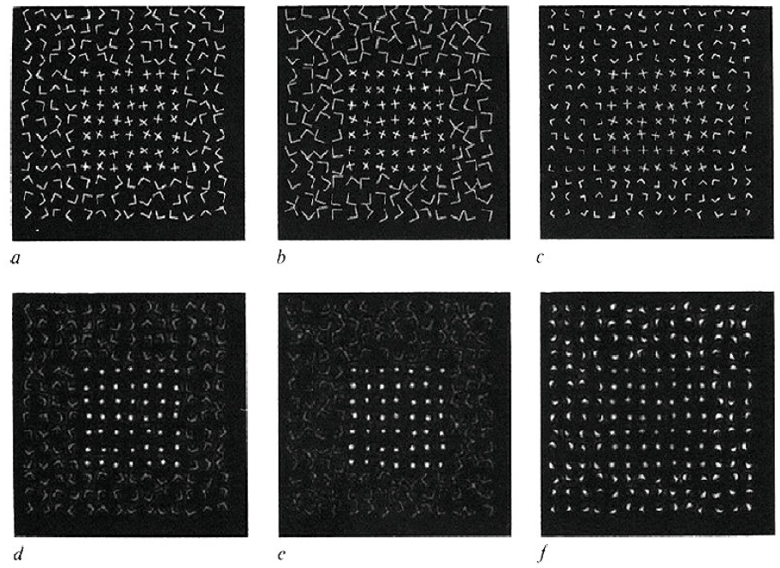
Capturing the local patterns with image measurements
[Bergen & Adelson, Nature 1988]
Scale of patterns influences discriminability
Size-tuned linear filters

Slide 20
Texture representation
Textures are made up of repeated local patterns, so:
Find the patterns
Use filters that look like patterns (spots, bars, raw patches…)
Consider magnitude of response
Describe their statistics within each local window
Mean, standard deviation
Histogram
Histogram of “prototypical” feature occurrences
Kristen Grauman

Slide 21
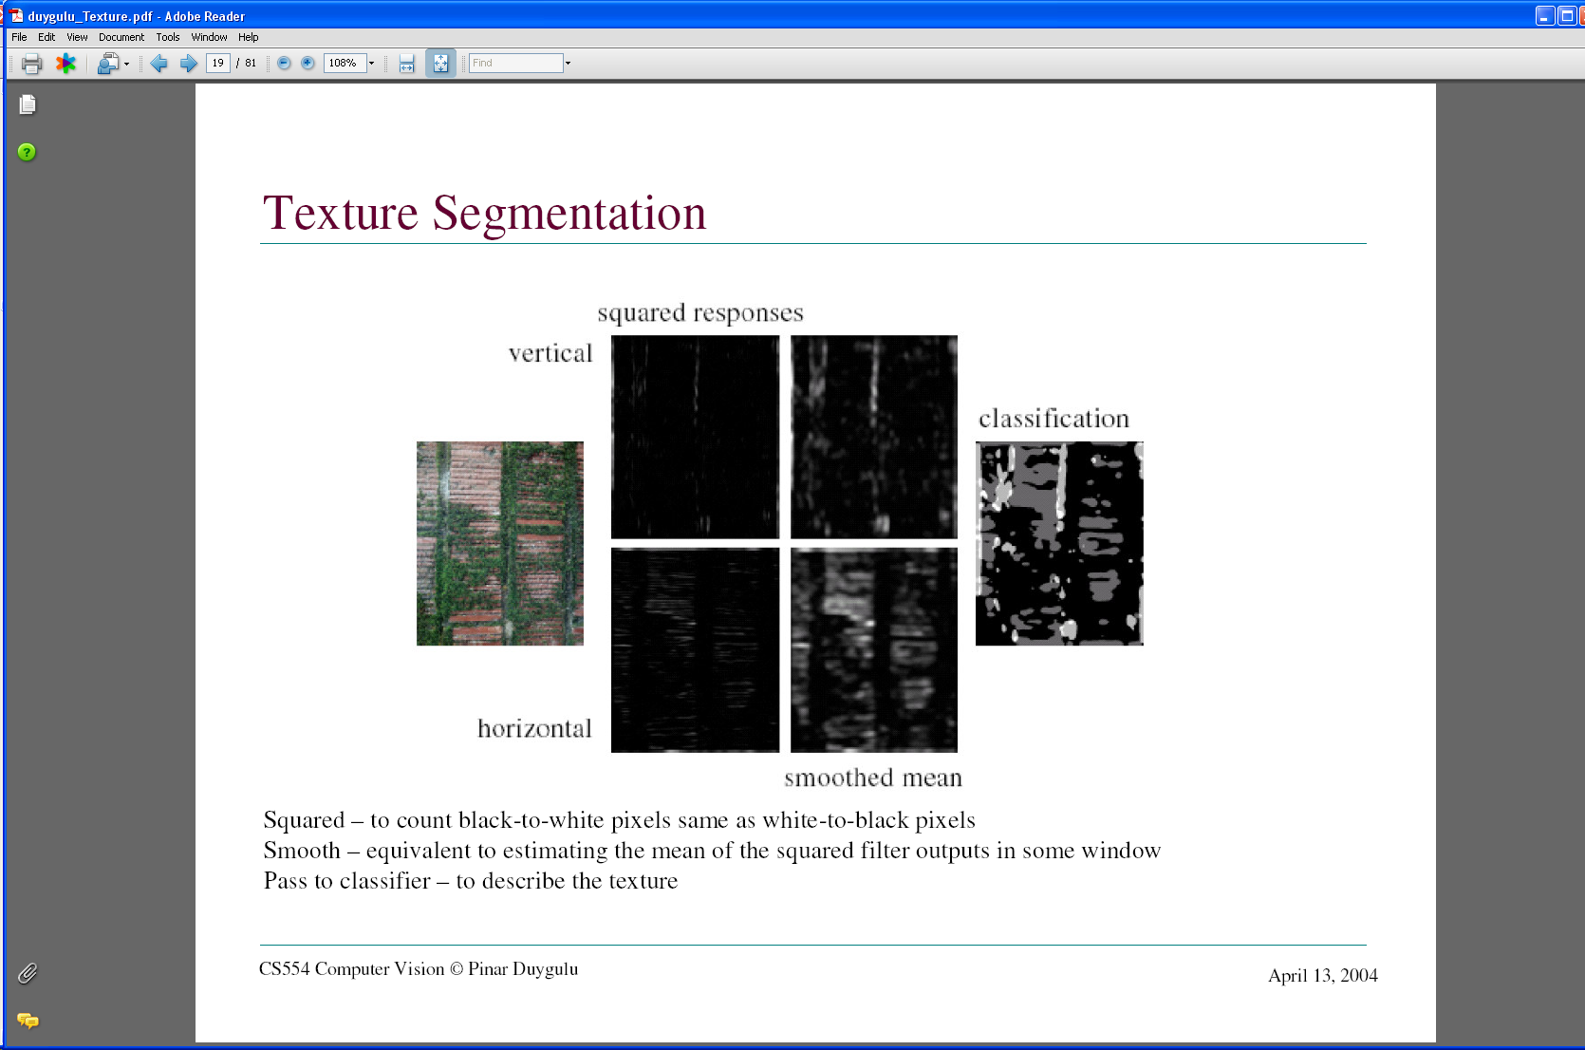
Texture representation: example
 | mean d/dx value | mean d/dy value
Win. #1 | 4 | 10
original image
…
statistics to summarize patterns in small windows
derivative filter responses, squared
Kristen Grauman

Slide 22
Texture representation: example
 | mean d/dx value | mean d/dy value
Win. #1 | 4 | 10
Win.#2 | 18 | 7
original image
…
statistics to summarize patterns in small windows
derivative filter responses, squared
Kristen Grauman

Slide 23
Texture representation: example
 | mean d/dx value | mean d/dy value
Win. #1 | 4 | 10
Win.#2 | 18 | 7
original image
…
statistics to summarize patterns in small windows
derivative filter responses, squared
Kristen Grauman

Slide 24
Texture representation: example
 | mean d/dx value | mean d/dy value
Win. #1 | 4 | 10
Win.#2 | 18 | 7
Win.#9 | 20 | 20
original image
…
…
statistics to summarize patterns in small windows
derivative filter responses, squared
Kristen Grauman

Slide 25
Texture representation: example
 | mean d/dx value | mean d/dy value
Win. #1 | 4 | 10
Win.#2 | 18 | 7
Win.#9 | 20 | 20
Dimension 2 (mean d/dy value)
Dimension 1 (mean d/dx value)
…
…
statistics to summarize patterns in small windows
Kristen Grauman

Slide 26
Texture representation: example
Windows with primarily horizontal edges
Both
 | mean d/dx value | mean d/dy value
Win. #1 | 4 | 10
Win.#2 | 18 | 7
Win.#9 | 20 | 20
Dimension 2 (mean d/dy value)
Dimension 1 (mean d/dx value)
…
…
statistics to summarize patterns in small windows
Windows with small gradient in both directions
Windows with primarily vertical edges
Kristen Grauman

Slide 27
Texture representation: example
original image
visualization of the assignment to texture “types”
derivative filter responses, squared
Kristen Grauman

Slide 28
Texture representation: example
 | mean d/dx value | mean d/dy value
Win. #1 | 4 | 10
Win.#2 | 18 | 7
Win.#9 | 20 | 20
Dimension 2 (mean d/dy value)
Far: dissimilar textures
Close: similar textures
Dimension 1 (mean d/dx value)
…
…
statistics to summarize patterns in small windows
Kristen Grauman

Slide 29
Texture representation: example
Dimension 2
Dimension 1
Kristen Grauman
Notes:
29

Slide 30
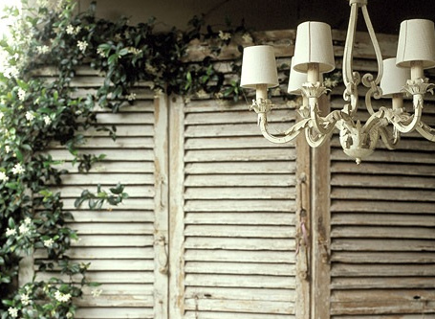
Texture representation: example
Dimension 2
Dimension 1
Distance reveals how dissimilar texture from window a is from texture in window b.
Kristen Grauman
Notes:
30

Slide 31
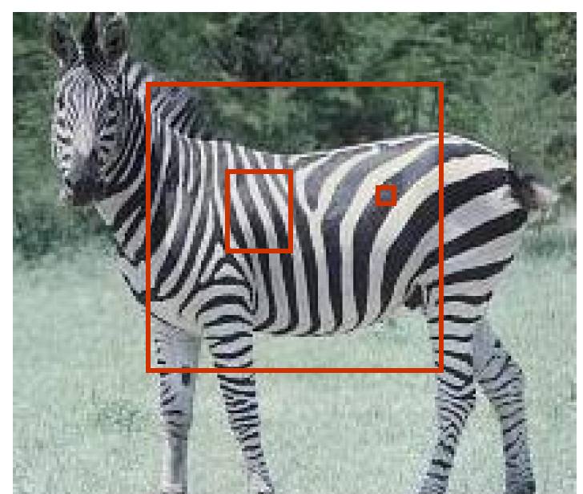
Texture representation: window scale
We’re assuming we know the relevant window size for which we collect these statistics.
Possible to perform scale selection by looking for window scale where texture description not changing.

Slide 32
Filter banks
Our previous example used two filters, and resulted in a 2-dimensional feature vector to describe texture in a window.
x and y derivatives revealed something about local structure.
We can generalize to apply a collection of multiple (d) filters: a “filter bank”
Then our feature vectors will be d-dimensional.
still can think of nearness, farness in feature space

Slide 33
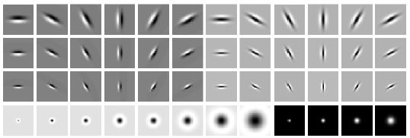
Filter banks
orientations
scales
“Edges”
“Bars”
“Spots”
What filters to put in the bank?
Typically we want a combination of scales and orientations, different types of patterns.
Matlab code available for these examples: http://www.robots.ox.ac.uk/~vgg/research/texclass/filters.html

Slide 34
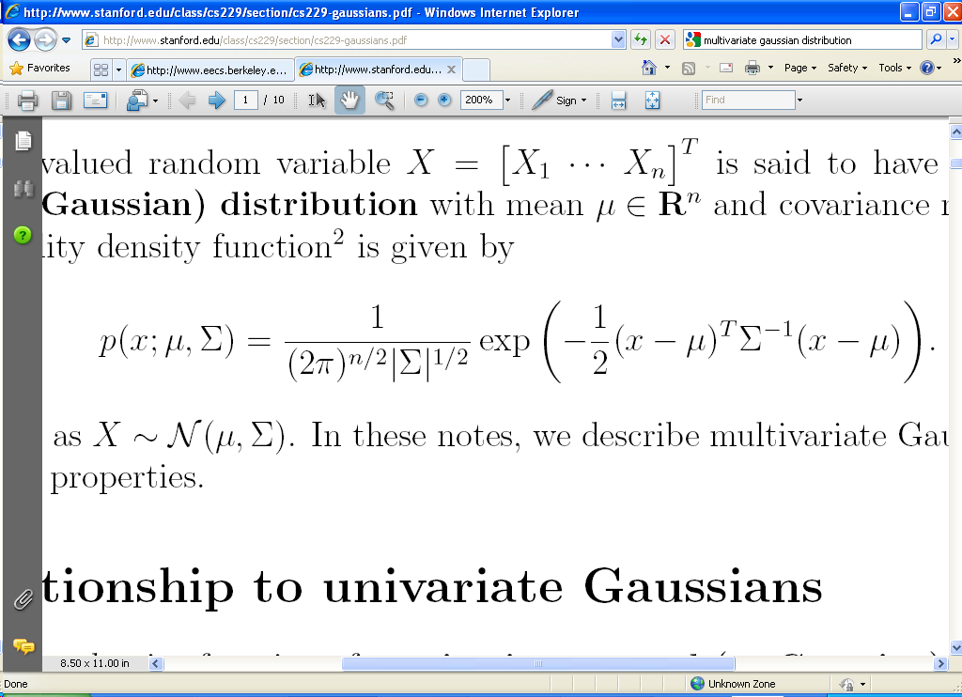
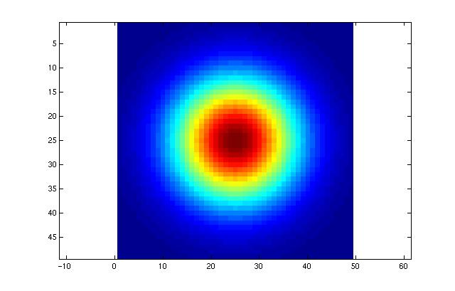
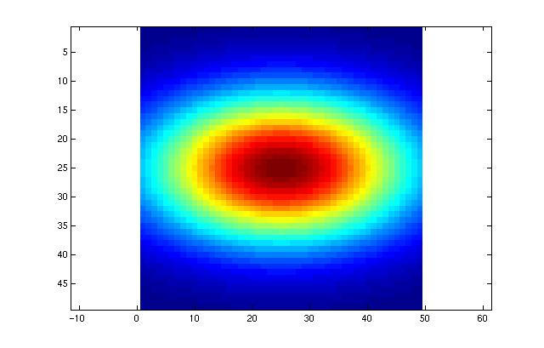
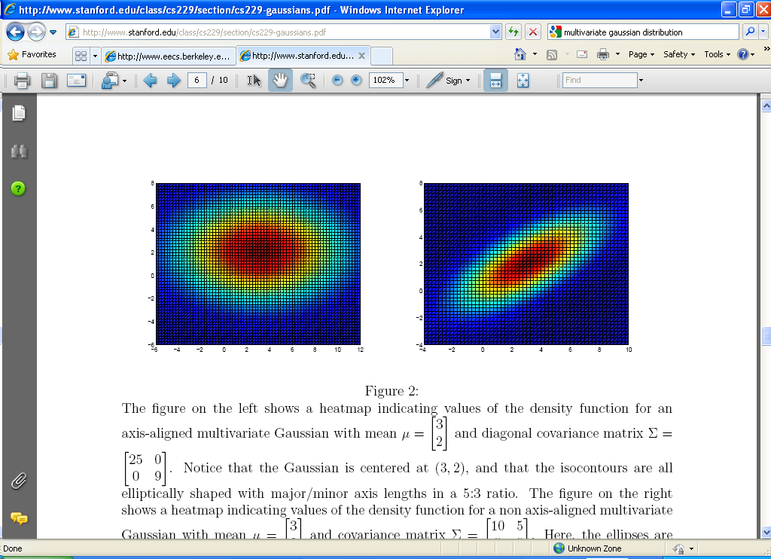
Multivariate Gaussian

Slide 35
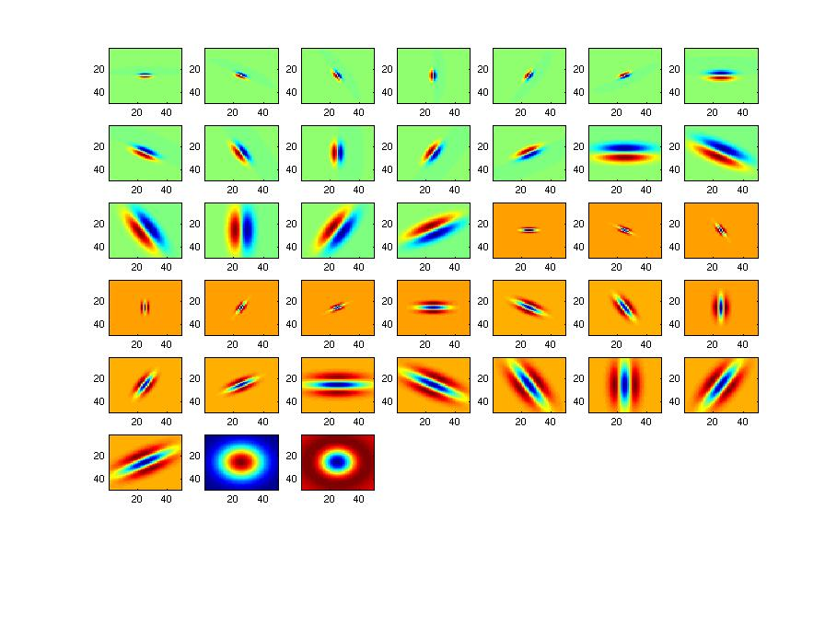
Filter bank

Slide 36
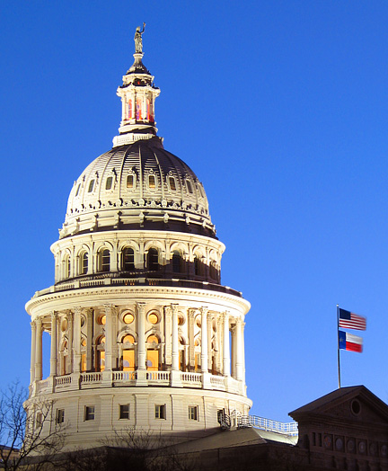
Image from http://www.texasexplorer.com/austincap2.jpg
Kristen Grauman

Slide 37
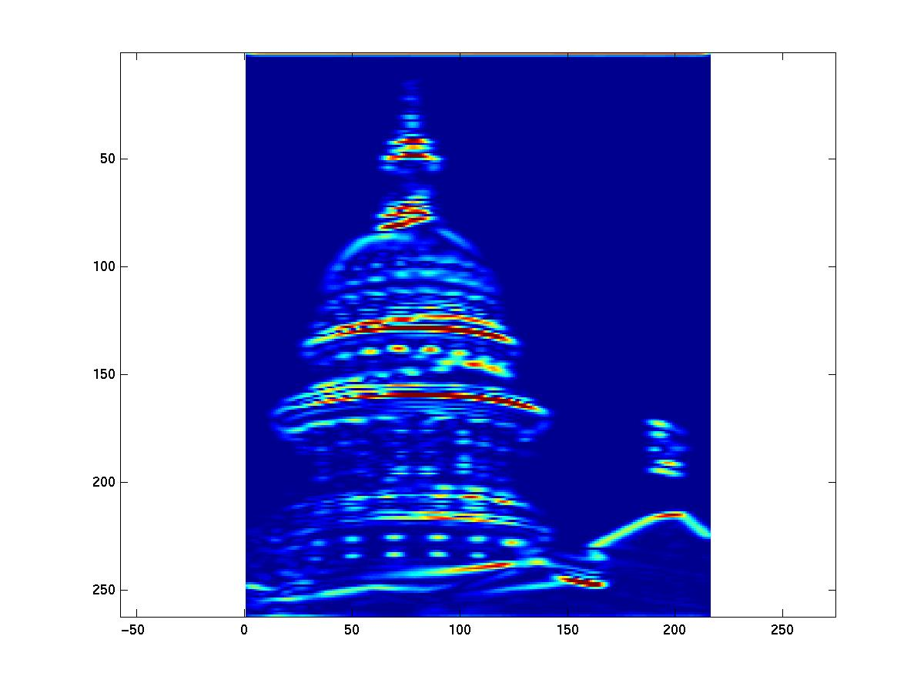
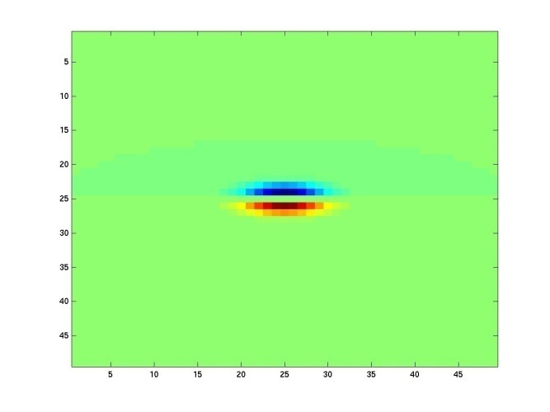
Showing magnitude of responses
Kristen Grauman

Slide 38
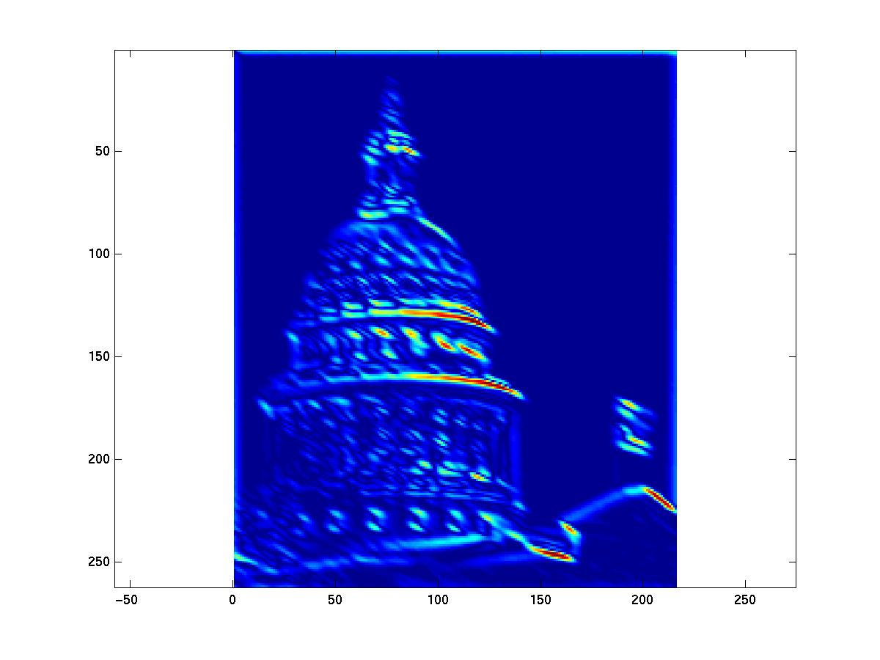
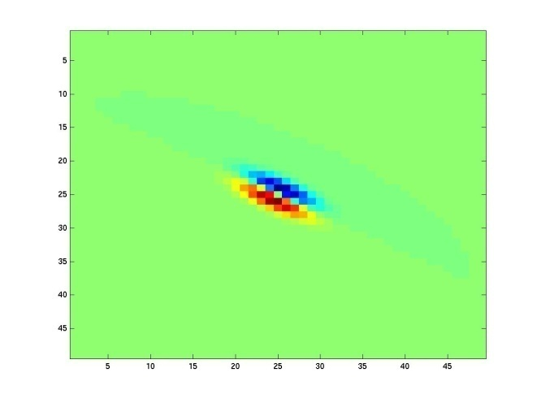
Kristen Grauman
Notes:
2

Slide 39
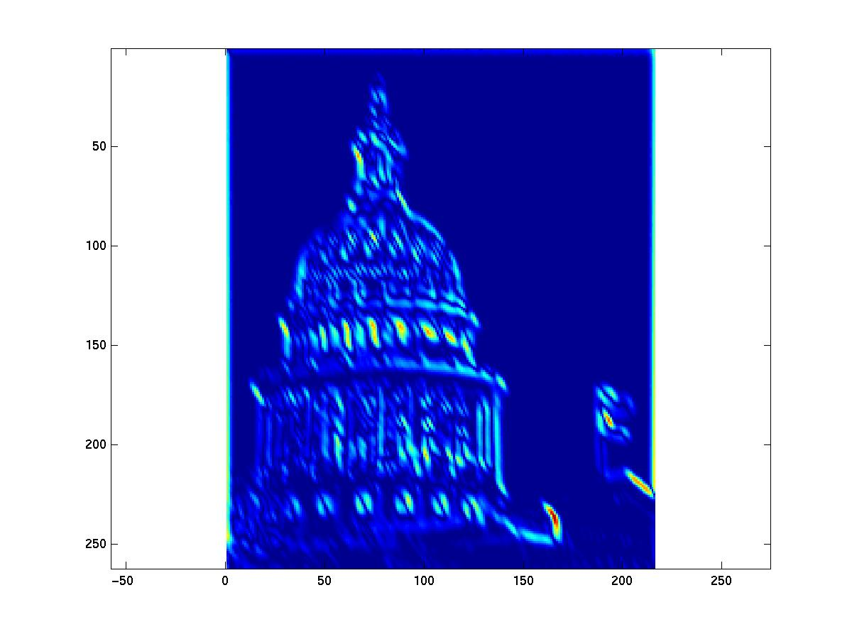
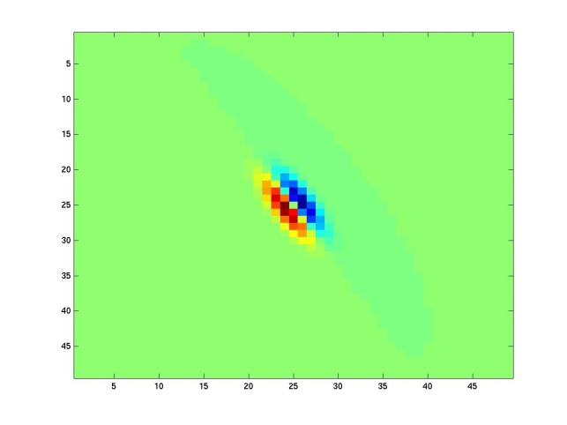
Kristen Grauman
Notes:
3

Slide 40
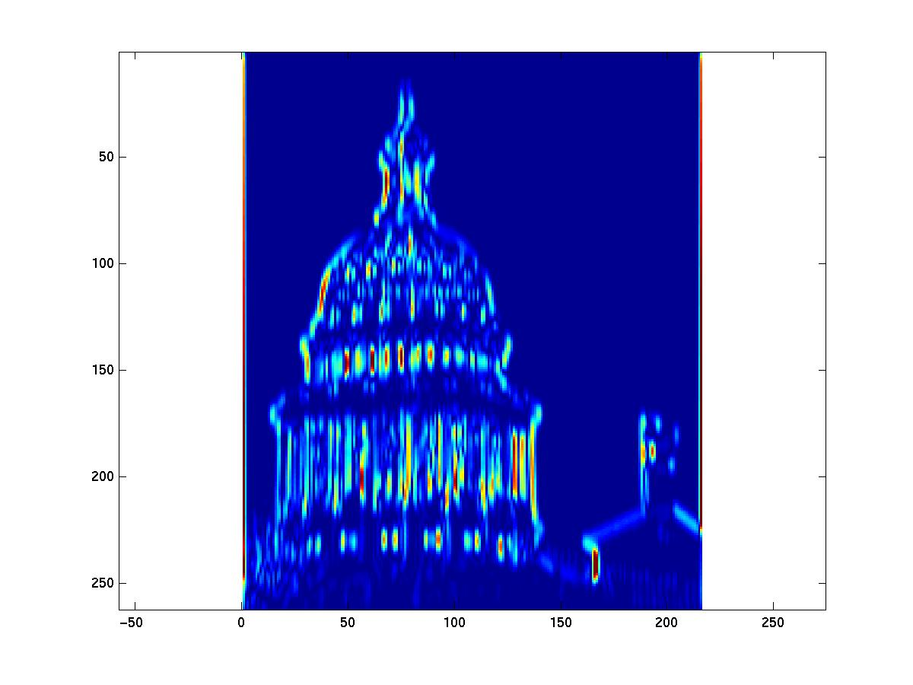
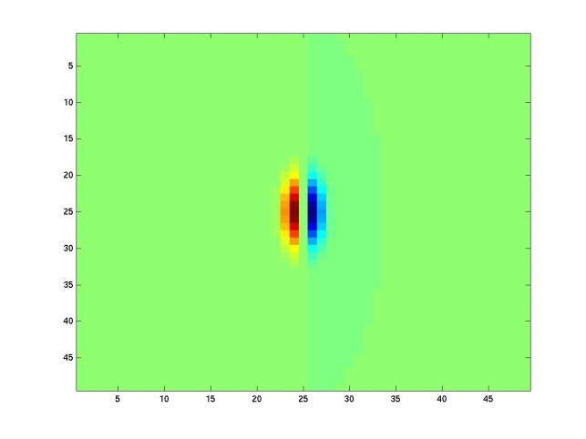
Kristen Grauman
Notes:
4

Slide 41
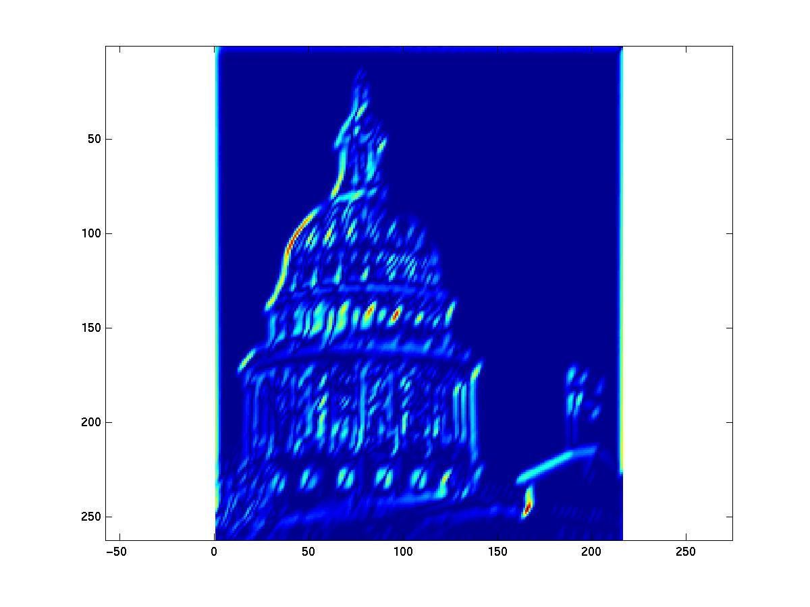
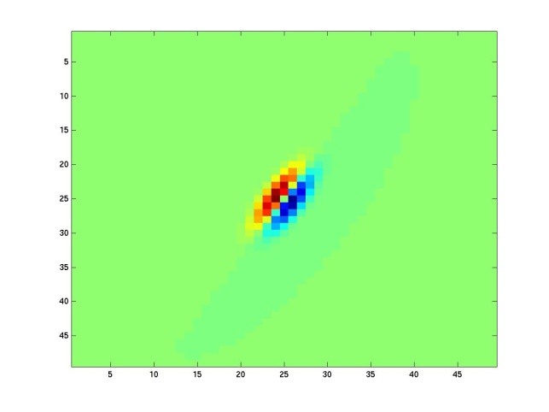
Kristen Grauman

Slide 42
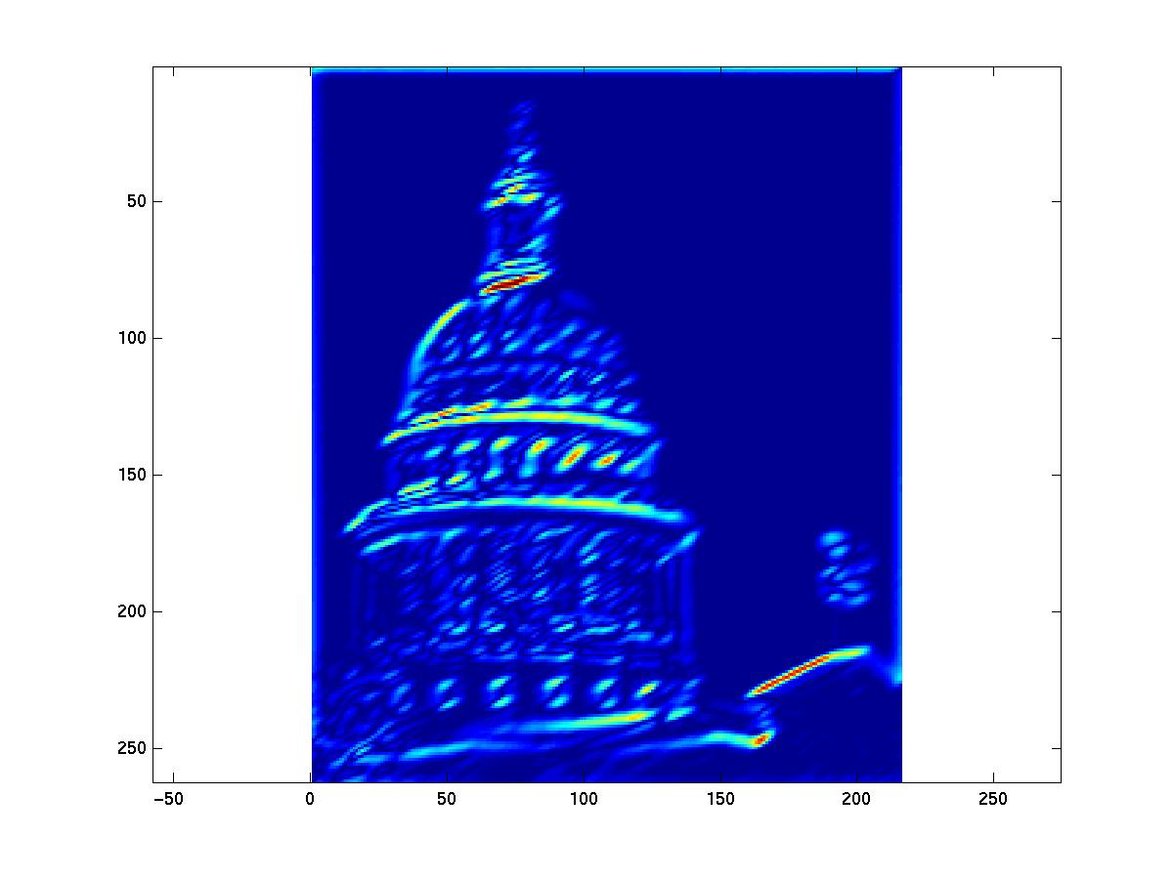
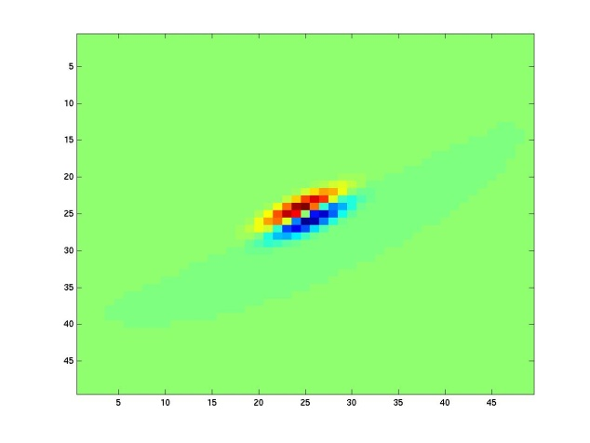
Kristen Grauman
Notes:
6

Slide 43
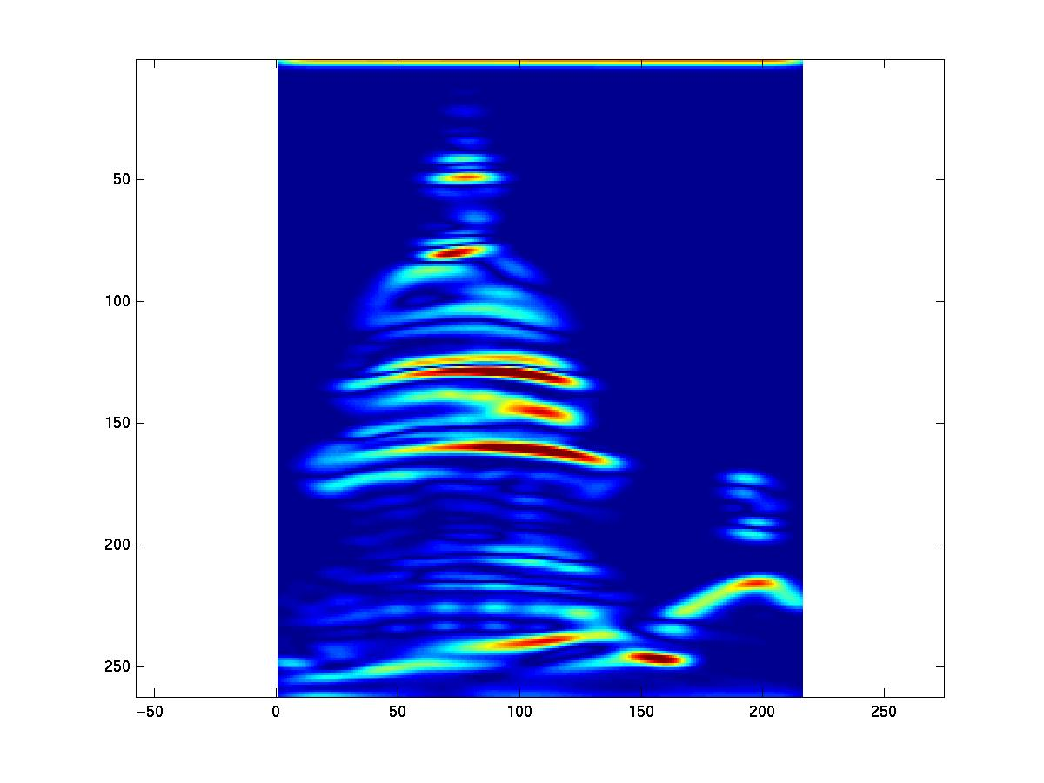
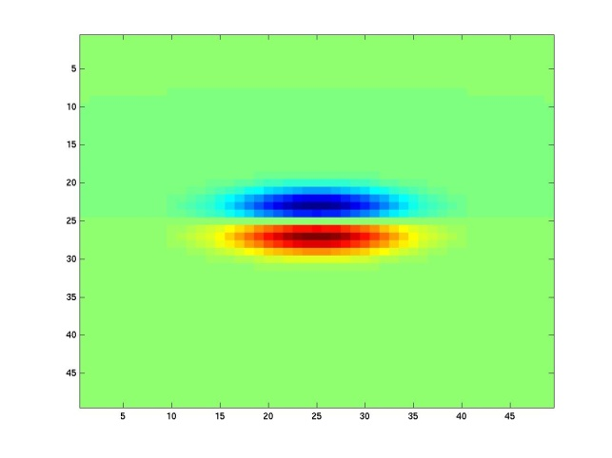
Kristen Grauman
Notes:
7

Slide 44


Kristen Grauman
Notes:
8

Slide 45


Kristen Grauman
Notes:
9

Slide 46


Kristen Grauman
Notes:
10

Slide 47


Kristen Grauman
Notes:
11

Slide 48


Kristen Grauman
Notes:
12

Slide 49


Kristen Grauman
Notes:
13

Slide 50


Kristen Grauman
Notes:
14

Slide 51


Kristen Grauman
Notes:
15

Slide 52


Kristen Grauman
Notes:
16

Slide 53


Kristen Grauman

Slide 54


Kristen Grauman
Notes:
18

Slide 55


Kristen Grauman

Slide 56






You try: Can you match the texture to the response?
Filters
A
B
1
2
C
3
Mean abs responses
Derek Hoiem

Slide 57

Representing texture by mean abs response
Filters
Mean abs responses
Derek Hoiem

Slide 58
[r1, r2, …, r38]
We can form a feature vector from the list of responses at each pixel.
Kristen Grauman

Slide 59
d-dimensional features
Euclidean distance (L₂)
. . .
2d
3d
Kristen Grauman

Slide 60
Example uses of texture in vision: analysis

Slide 61

Classifying materials, “stuff”
Figure by Varma & Zisserman
Kristen Grauman

Slide 62

Texture features for image retrieval
Y. Rubner, C. Tomasi, and L. J. Guibas. The earth mover's distance as a metric for image retrieval. International Journal of Computer Vision, 40(2):99-121, November 2000,
Kristen Grauman

Slide 63


Characterizing scene categories by texture
L. W. Renninger and J. Malik. When is scene identification just texture recognition? Vision Research 44 (2004) 2301–2311

Slide 64

Segmenting aerial imagery by textures
http://www.airventure.org/2004/gallery/images/073104_satellite.jpg

Slide 65
Texture-related tasks
Shape from texture
Estimate surface orientation or shape from image texture
Segmentation/classification from texture cues
Analyze, represent texture
Group image regions with consistent texture
Synthesis
Generate new texture patches/images given some examples

Slide 66
Texture synthesis
Goal: create new samples of a given texture
Many applications: virtual environments, hole-filling, texturing surfaces

Slide 67


The Challenge
Need to model the whole spectrum: from repeated to stochastic texture
repeated
Alexei A. Efros and Thomas K. Leung, “Texture Synthesis by Non-parametric Sampling,” Proc. International Conference on Computer Vision (ICCV), 1999.
stochastic
Both?

Slide 68









Markov Chains
Markov Chain
a sequence of random variables
is the state of the model at time t
Markov assumption: each state is dependent only on the previous one
dependency given by a conditional probability:
The above is actually a first-order Markov chain
An N’th-order Markov chain:
Source S. Seitz

Slide 69

Markov Chain Example: Text
“A dog is a man’s best friend. It’s a dog eat dog world out there.”
a
 | 2/3 |  | 1/3
 |  | 1/3 |  |  |  |  | 1/3 | 1/3
1
 |  |  |  | 1
 |  |  |  |  | 1
 |  |  |  |  |  |  |  |  |  |  | 1
1
 | 1
 |  |  |  |  |  |  |  |  | 1
 |  |  |  |  |  |  |  |  |  | 1
 |  |  |  |  |  |  |  |  |  |  | 1
 |  |  |  |  |  | 1
dog
is
man’s
best
friend
it’s
eat
world
out
there
.
a
dog
is
it’s
eat
out
.
best
friend
there
man’s
world
Source: S. Seitz

Slide 70



Text synthesis
Create plausible looking poetry, love letters, term papers, etc.
Most basic algorithm
Build probability histogram
find all blocks of N consecutive words/letters in training documents
compute probability of occurrence
Given words
compute by sampling from
WE NEED
TO
EAT
CAKE
Source: S. Seitz

Slide 71
Text synthesis
Results:
“As I've commented before, really relating to someone involves standing next to impossible.”
"One morning I shot an elephant in my arms and kissed him.”
"I spent an interesting evening recently with a grain of salt"
Dewdney, “A potpourri of programmed prose and prosody” Scientific American, 1989.
Slide from Alyosha Efros, ICCV 1999

Slide 72

Synthesizing Computer Vision text
What do we get if we extract the probabilities from a chapter on Linear Filters, and then synthesize new statements?
Check out Yisong Yue’s website implementing text generation: build your own text Markov Chain for a given text corpus. http://www.yisongyue.com/shaney/index.php
Kristen Grauman

Slide 73
Synthesized text
This means we cannot obtain a separate copy of the best studied regions in the sum.
All this activity will result in the primate visual system.
The response is also Gaussian, and hence isn’t bandlimited.
Instead, we need to know only its response to any data vector, we need to apply a low pass filter that strongly reduces the content of the Fourier transform of a very large standard deviation.
It is clear how this integral exist (it is sufficient for all pixels within a 2k +1 × 2k +1 × 2k +1 × 2k + 1 — required for the images separately.
Kristen Grauman

Slide 74

Markov Random Field
A Markov random field (MRF)
generalization of Markov chains to two or more dimensions.
First-order MRF:
probability that pixel X takes a certain value given the values of neighbors A, B, C, and D:
A
D
X
B
C
Source: S. Seitz

Slide 75




Texture Synthesis [Efros & Leung, ICCV 99]
Can apply 2D version of text synthesis
Texture corpus (sample)
Output

Slide 76

Texture synthesis: intuition
Before, we inserted the next word based on existing nearby words…
Now we want to insert pixel intensities based on existing nearby pixel values.
Place we want to insert next
Sample of the texture
(“corpus”)
Distribution of a value of a pixel is conditioned on its neighbors alone.

Slide 77


Synthesizing One Pixel
p
synthesized image
input image
What is ?
Find all the windows in the image that match the neighborhood
To synthesize x
pick one matching window at random
assign x to be the center pixel of that window
An exact neighbourhood match might not be present, so find the best matches using SSD error and randomly choose between them, preferring better matches with higher probability
Slide from Alyosha Efros, ICCV 1999

Slide 78




Neighborhood Window
input
Slide from Alyosha Efros, ICCV 1999

Slide 79









Varying Window Size
Increasing window size
Slide from Alyosha Efros, ICCV 1999

Slide 80



Growing Texture
Starting from the initial image, “grow” the texture one pixel at a time
Slide from Alyosha Efros, ICCV 1999

Slide 81




Synthesis results
french canvas
rafia weave
Slide from Alyosha Efros, ICCV 1999

Slide 82


Synthesis results
white bread
brick wall
Slide from Alyosha Efros, ICCV 1999

Slide 83


Synthesis results
Slide from Alyosha Efros, ICCV 1999

Slide 84




Failure Cases
Growing garbage
Verbatim copying
Slide from Alyosha Efros, ICCV 1999

Slide 85






Hole Filling
Slide from Alyosha Efros, ICCV 1999

Slide 86




Extrapolation
Slide from Alyosha Efros, ICCV 1999

Slide 87
The Efros & Leung algorithm
Simple
Surprisingly good results
Synthesis is easier than analysis!
…but very slow

Slide 88
Image Quilting [Efros & Freeman 2001]
non-parametric
sampling
p
B
Input image
Synthesizing a block
Observation: neighbor pixels are highly correlated
Idea: unit of synthesis = block
Exactly the same but now we want P(B|N(B))
Much faster: synthesize all pixels in a block at once
Slide from Alyosha Efros, ICCV 1999

Slide 89







Input texture
block
B1
B2
B1
B2
B1
B2
Random placement
of blocks
Neighboring blocks
constrained by overlap
Minimal error
boundary cut

Slide 90








Minimal error boundary
overlapping blocks
vertical boundary
2
_
=
overlap error
min. error boundary
Slide from Alyosha Efros

Slide 91





Slide 92





Slide 94





Slide 95



Slide 96






Slide 97
Failures
(Chernobyl
Harvest)

Slide 98

Texture Transfer
Take the texture from one object and “paint” it onto another object
This requires separating texture and shape
That’s HARD, but we can cheat
Assume we can capture shape by boundary and rough shading
Then, just add another constraint when sampling: similarity to underlying image at that spot

Slide 99
parmesan
+
=
rice
+
=

Slide 100



+
=

Slide 101




+
=

Slide 102

(Manual) texture synthesis in the media

Slide 103
(Manual) texture synthesis in the media

Slide 104

http://www.dailykos.com/story/2004/10/27/22442/878

Slide 105


Synthesizing textures when constructing
3d models of archaeological sites
A. Zalesny et al., Realistic Textures for Virtual Anastylosis

Slide 106
Summary
Texture is a useful property that is often indicative of materials, appearance cues
Texture representations attempt to summarize repeating patterns of local structure
Filter banks useful to measure redundant variety of structures in local neighborhood
Feature spaces can be multi-dimensional
Neighborhood statistics can be exploited to “sample” or synthesize new texture regions
Example-based technique
Kristen Grauman

Slide 107










features and filters
Transforming and describing images; textures, colors, edges

